Slide 1
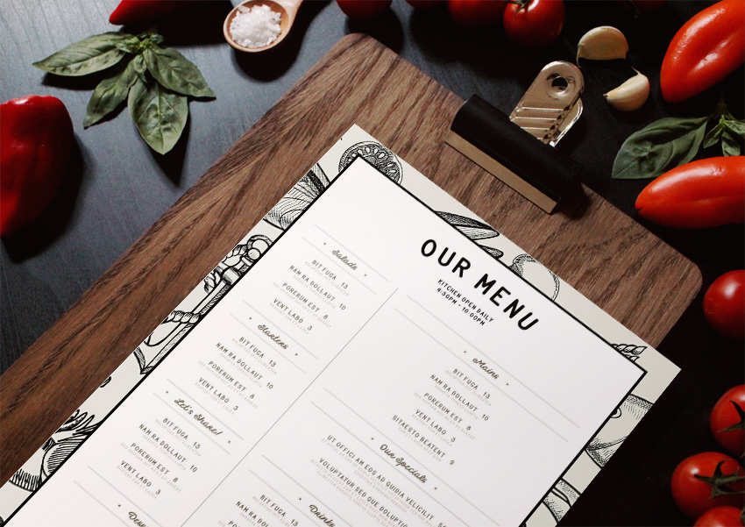
Restaurant

Slide 2
Restaurant database
The project is about creating a database for a restaurant by creating tables, relationship between tables, queries, forms and reports

Slide 3
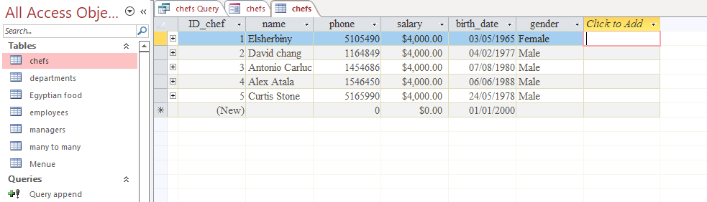
Tables
1
Chefs table

Slide 4
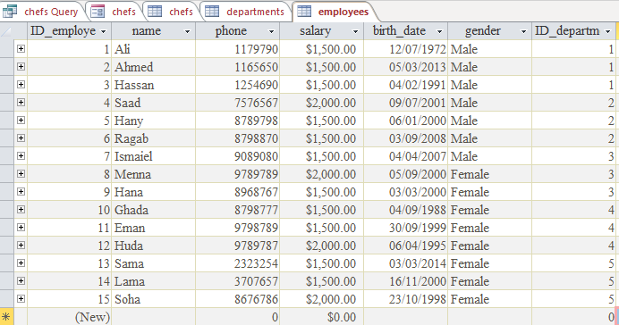
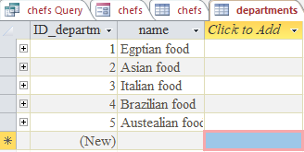
Tables
1
Employee table
Department table

Slide 5
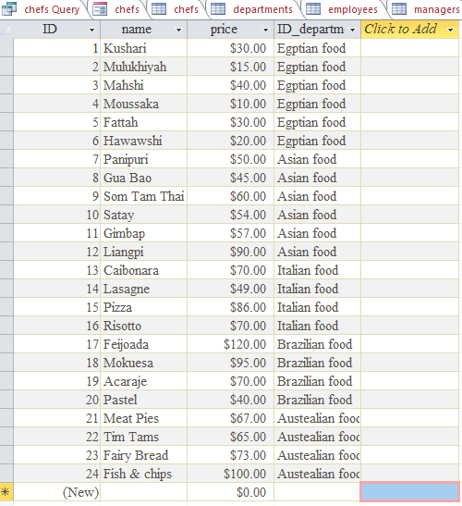
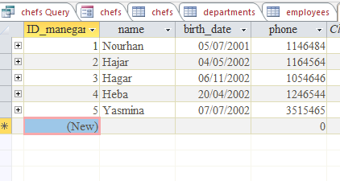
Tables
1
Menu table
Managers table

Slide 6
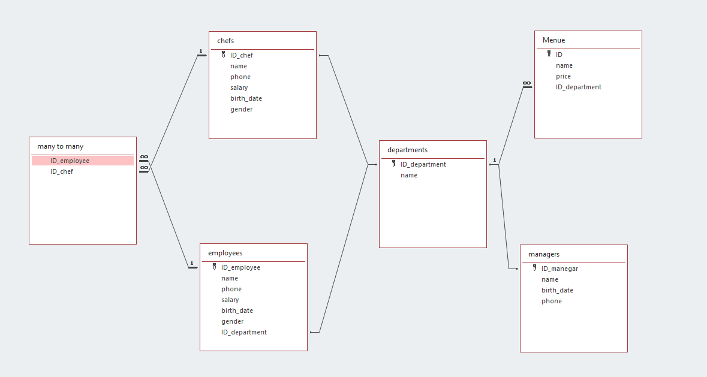
Relationships between tables
Connect tables using relationships
[ERD]

Slide 7
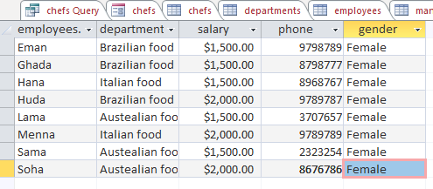
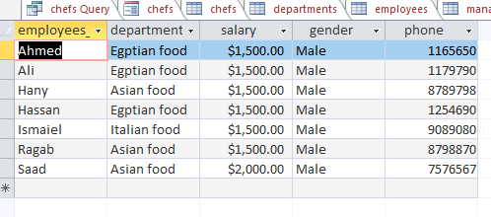
Queries
2
Chefs query
Employee Male
query

Slide 8
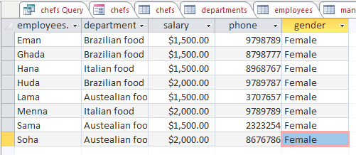
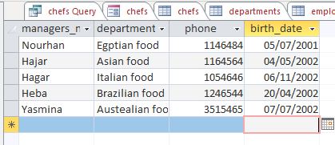
Queries
2
Employee female
query
Managers query

Slide 9
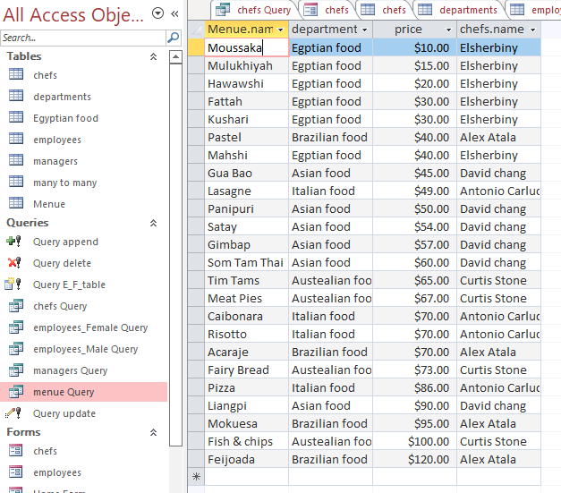
Queries
2
Menu query

Slide 10
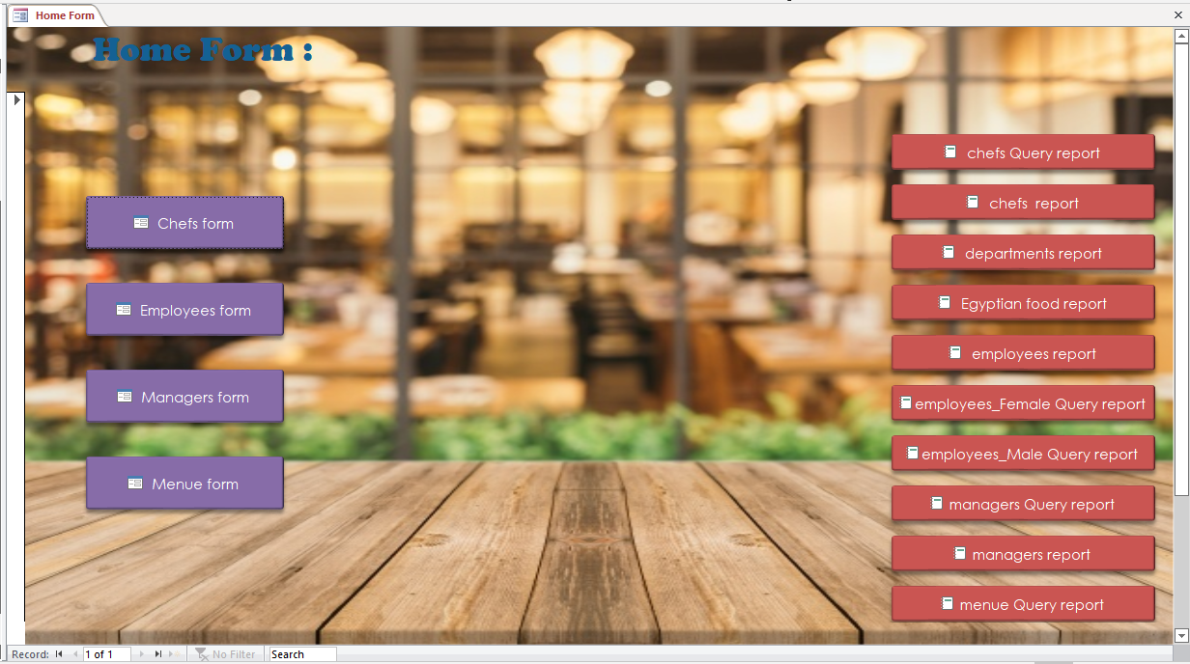
Forms
3
Home form

Slide 11
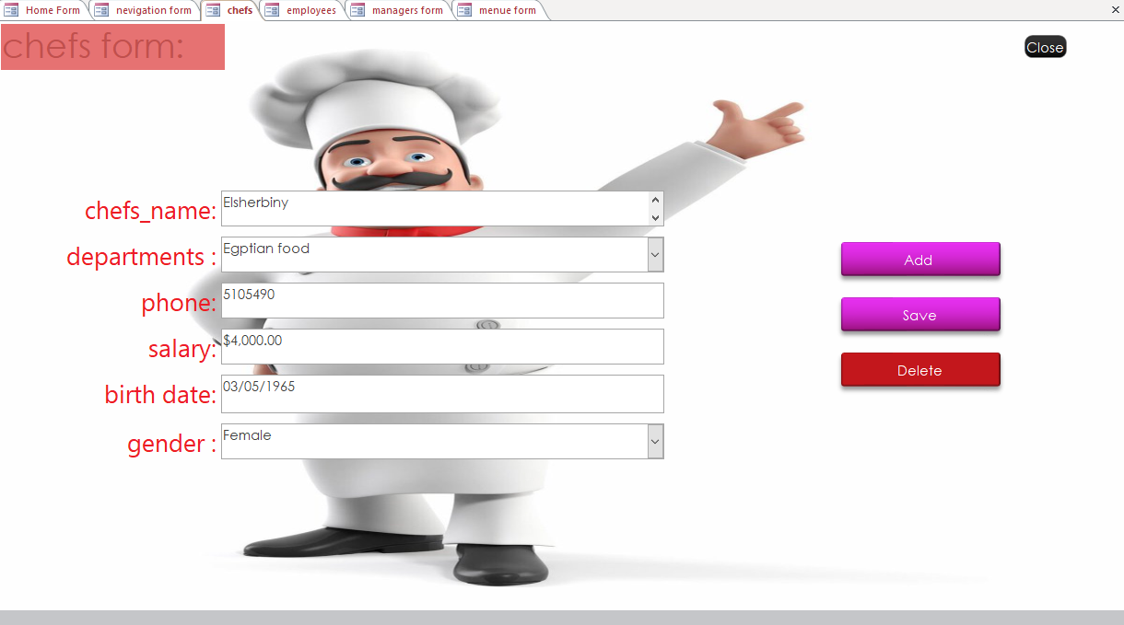
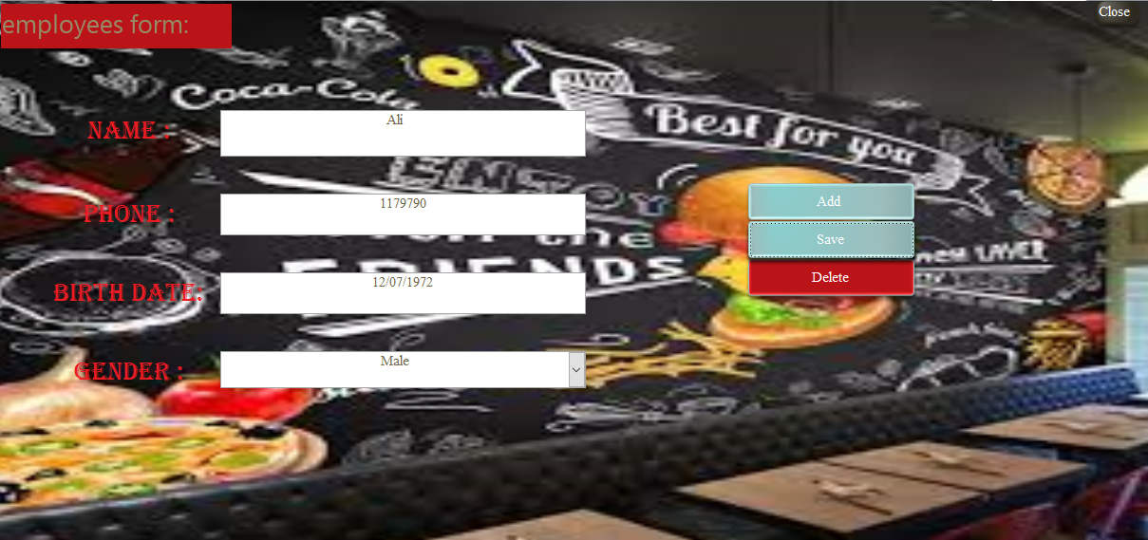
Forms
3
Chefs form
Employees form

Slide 12
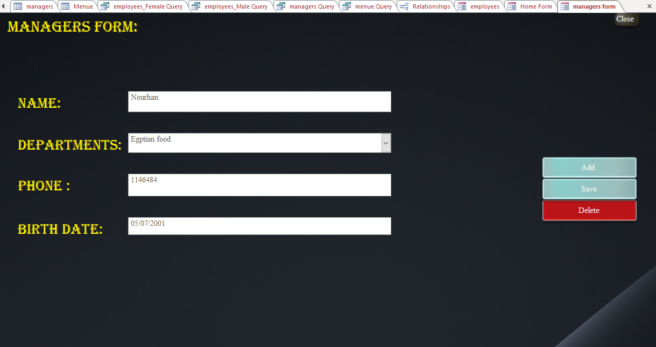
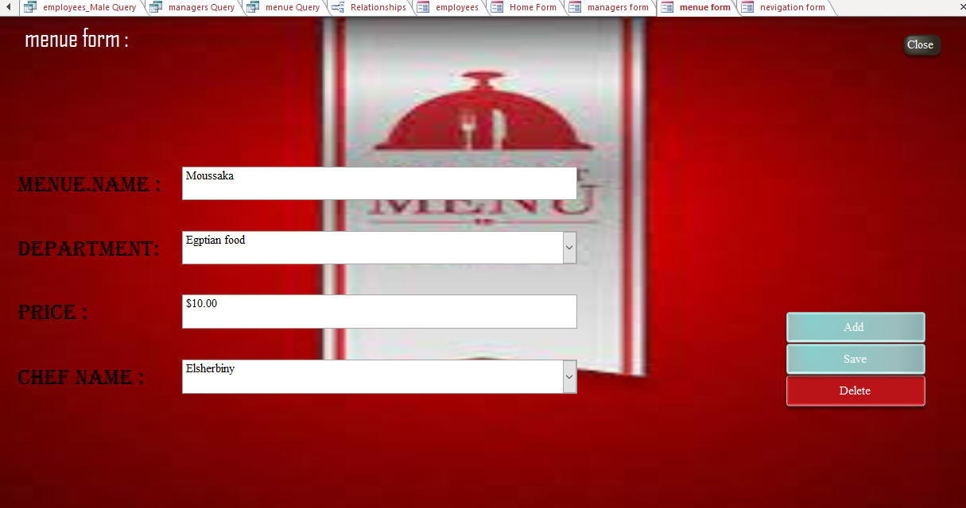
Forms
3
Managers form
Menu form

Slide 13
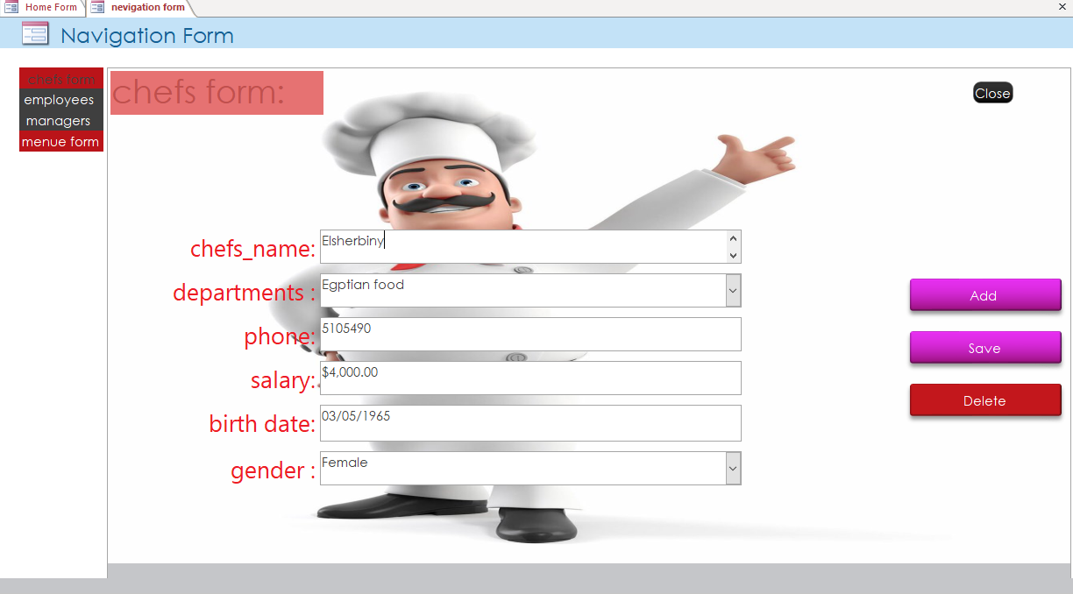
Forms
3
Navigation form

Slide 14
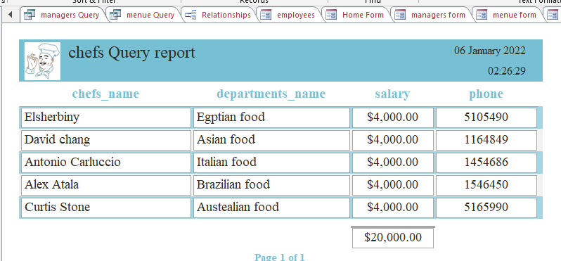
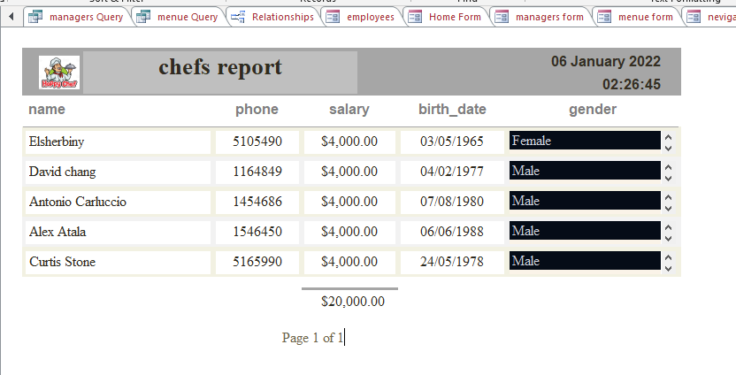
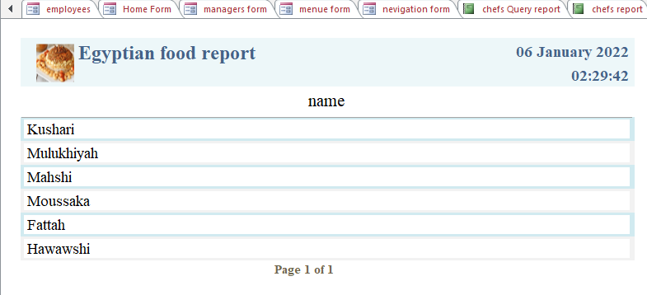
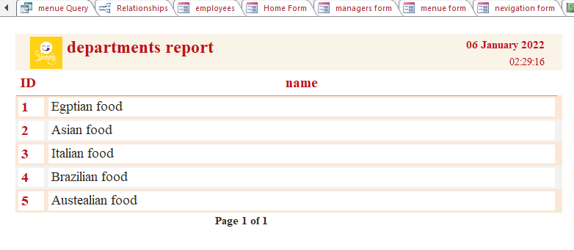
Reports
4
Chefs query report
Chefs report
Egyptian food report
Departments report

Slide 15
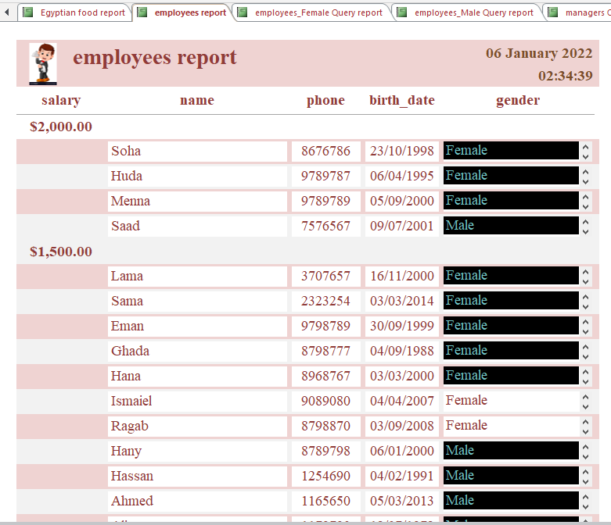
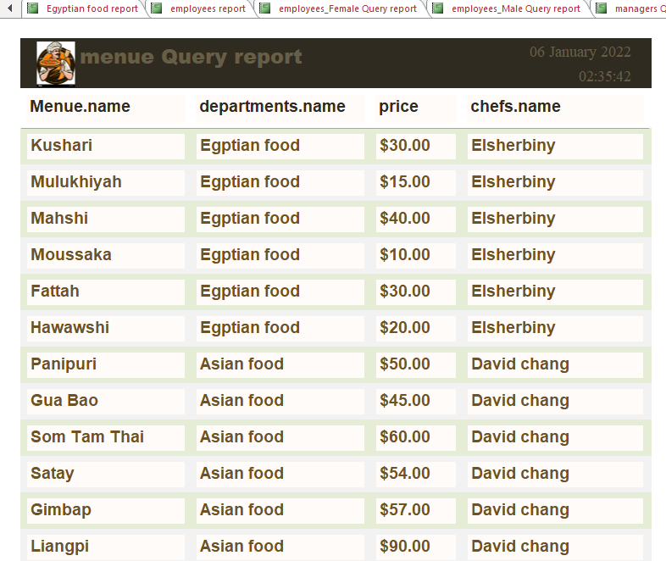
Reports
4
Employee report
Menu query report

Slide 16
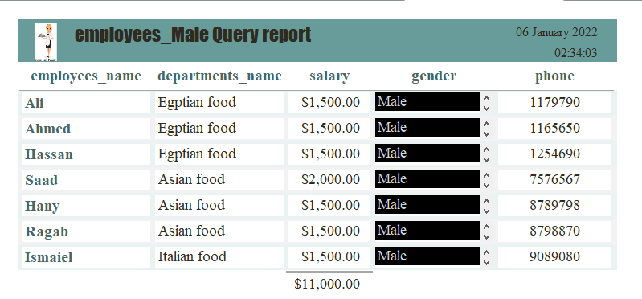
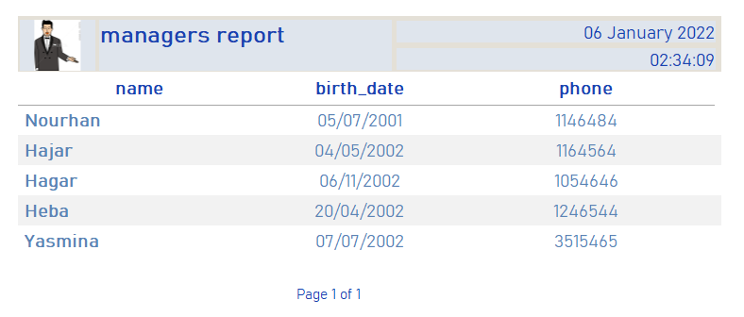
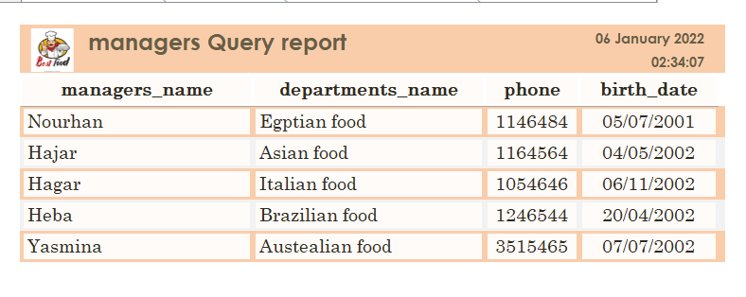
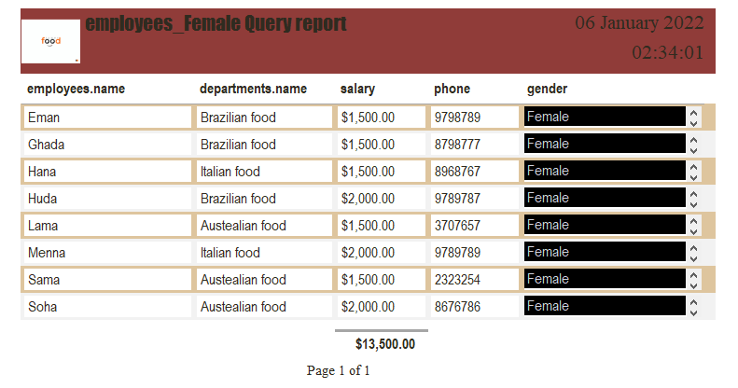
Reports
4
Employee male query report
Managers report
Managers query report
Employee female query report

Slide 17
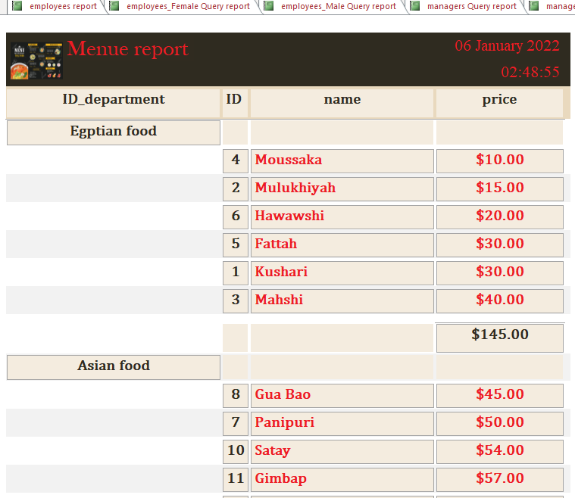
Reports
4
Menu report

Slide 18
Team 61
GitHub link :
https://github.com/yasmine1301/is.com.git
Nourhan Badran Zahgar
Hajar Ahmed Hassan Ali
Hajar Abdul Rahman Farhan Youssef
Heba Othman Ramadan Abdallah
Yasmine Sofian AbdelShakour Tawfik

